Slide 1

Replication of Chowgacha UHC Model in 3 UHC 0f Tangail distritct.
Dr. Md Emdadul Haque
National Consultant (HEU).

Slide 2
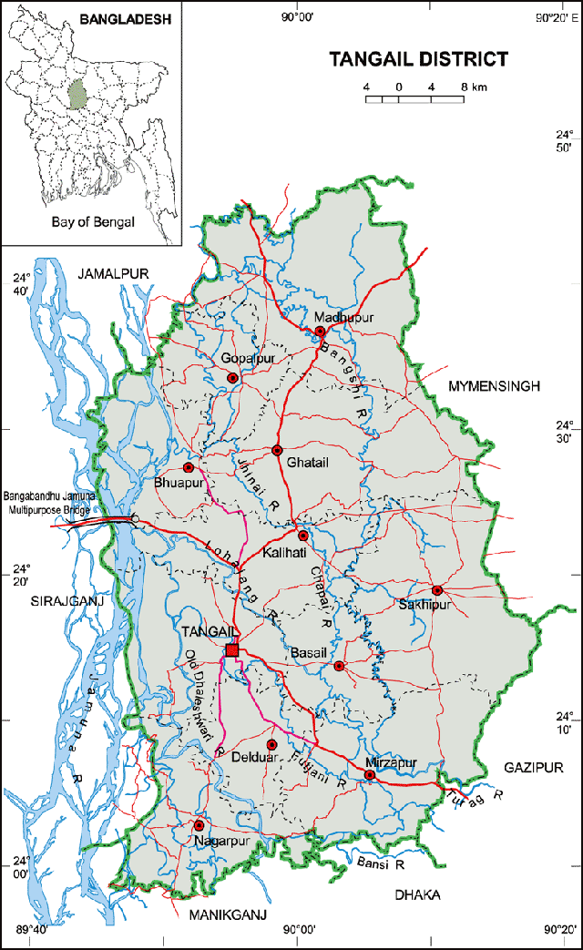
Map of Tangail district

Slide 3
Criteria Of C-J Model.
Criteria of C-J Model | Best | good | Weak
1.Cycle stand close to the main gate.
2.Health Education
3.Cleanliness & beautification
4.Separation of patients in out door & indoor
5.Blood doner list with 24/7 B.T facility
6.Birth- death recording

Slide 4
Criteria of C-J Model.
Criteria of C-J Model. | Best | Good | Week
7. Reception Desk
8 . Developed Emergency Dept.
9. 5S –KAIZEN implementation.
10. Community Participation.
11. Hospital activities Display
12. Corner based service.
13. Cash counter for receiving Govt money.

Slide 5
Criteria of C-J Model.
Criteria of C-J Model. | Best | Good | Week
14.Devolped maternal health/labour word.
15.Devolped paediatric health
16.Position in HSS score
17. Power point Presentation &Video on UHC
18.Knowledge about 7th Five Year plan & SDG.
19.Zero-Tollarance on corruption

Slide 6
EOC- Team formation
UH&FPO-Chair person.
UFPO -Vice char person.
Consultant (Pediatric)
RMO
MO(MCH&FP)
MO(Female)-2
MO(SSK)
UFC(SSK)
Sn FWV
Nursing Supervisor
OT Sister.
EOC WORD in charge SSN
MT (Lab)
Consultant (Obst & Gynae)-Member secretary.

Slide 7
Selection criteria of UHC
Distance from Tangail.
Poverty status.
Criteria of C-J Model.
Attitude of the service provider.
Location of the health complex.

Slide 8
Basic information the mothers of Tangail..
Total population 41,00000.
Total pregnant mother 1,00,000/year.
Total delivery 90,000/year
Total maternal death 156/year.
Total maternal morbidity 4680/year.
Total perinatal death 2700/year.
Total perinatal morbidity 9,000/year.
Total low birth weight 18,ooo/year.
.

Slide 9
Basic EOC Services.
Assisted vaginal delivery by ventouse.
Repear of episiotomy wound.
Administration of parenteral antibiotic
Administration of parenteral anticonvulsant.
Administration of parenteral uterotonic agent.
Manual removal of placenta& retained product of conception(MVA or DE&C)

Slide 10
Comprehensive EOC Services.
Assisted vaginal delivery by ventouse.
Repear of episiotomy wound.
Administration of parenteral antibiotic
Administration of parenteral anticonvulsant.
Administration of parenteral uterotonic agent.
Manual removal of placenta& retained product of conception(MVA or DE&C)
+
Anesthesia service.
C-Section.
Blood transfusion.

Slide 11

Thank you

